Slide 1
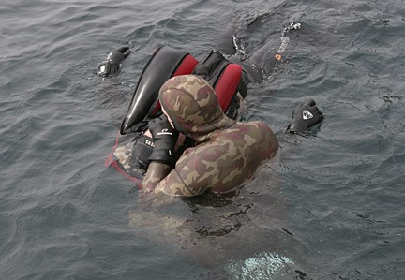
First Aid & CPR
Rescue Breathing

Slide 2
First Aid & CPR
Rescue Breathing
Introduction
What are the steps to follow in an emergency situation?
Check, Call, Care

Slide 3
First Aid & CPR
Rescue Breathing
Objectives
Students will be able to:
Indentify & understand the
procedure for rescue breathing
Practice rescue breathing

Slide 4
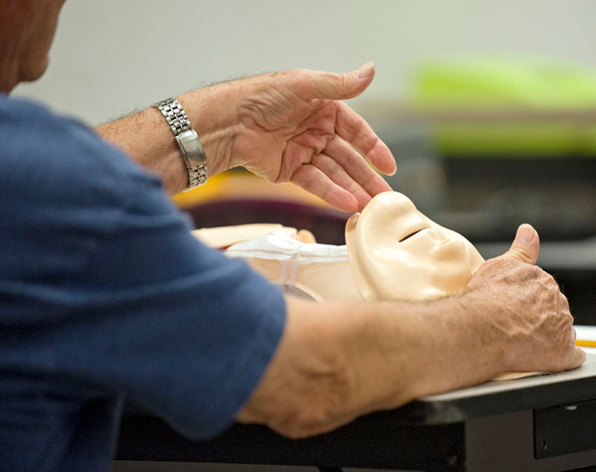
First Aid & CPR
Rescue Breathing
During Primary Survey:
Check - Call - Care
ABC’s
Open the Airway
  Head Tilt-Chin Lift
LLF for breathing
(5-10 sec)
Circulation
Call 911

Slide 5
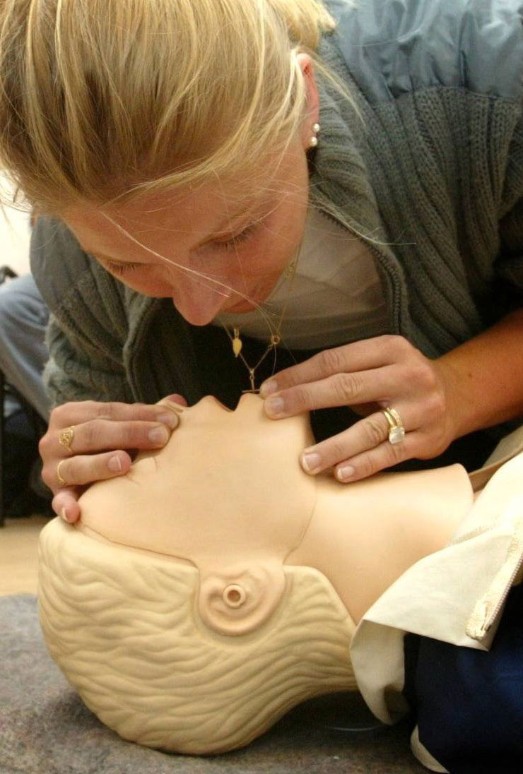
First Aid & CPR
Rescue Breathing
Mouth-to-mouth
Pinch nose shut
Take a breath
Make complete seal around person’s mouth
Give breath until you see chest clearly rise
Pause between breaths to let air flow out
Adult & child

Slide 6
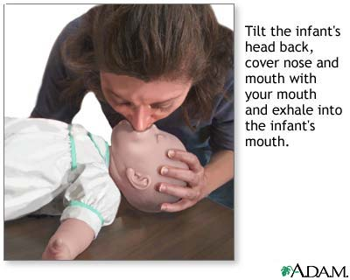
First Aid & CPR
Rescue Breathing
Mouth-to-mouth/nose
Take a breath
Make complete seal around infants’ mouth & nose
Give breath until you see chest clearly rise
Breathe gently (Puff)
Pause between breaths to let air flow out
Infant

Slide 7
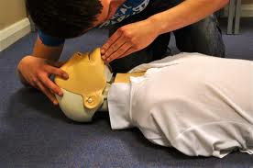
First Aid & CPR
Rescue Breathing
During Primary Survey:
Check - Call - Care
ABC’s
Open the Airway
LLF for breathing
(5-10 sec)
NOT Breathing
Circulation – Has pulse
Call 911
Give rescue breaths

Slide 8
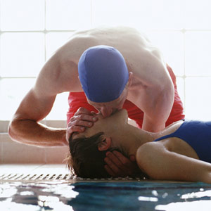
First Aid & CPR
Rescue Breathing
Call 911
Deliver 2 full slow breaths
If air does NOT go into the lungs
Re-adjust head tilt
Give 2 more full slow breaths
Lungs fill with air
Pulse (10 seconds)
Has pulse continue breaths

Slide 9
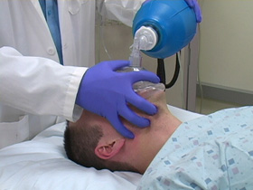
First Aid & CPR
Rescue Breathing
Adult Rescue Breaths:
Call 911
Give 2 initial breaths
Search for a Pulse (5-10 sec)
Maintain open airway
Deliver 1 full slow breath every 5 seconds

Slide 10
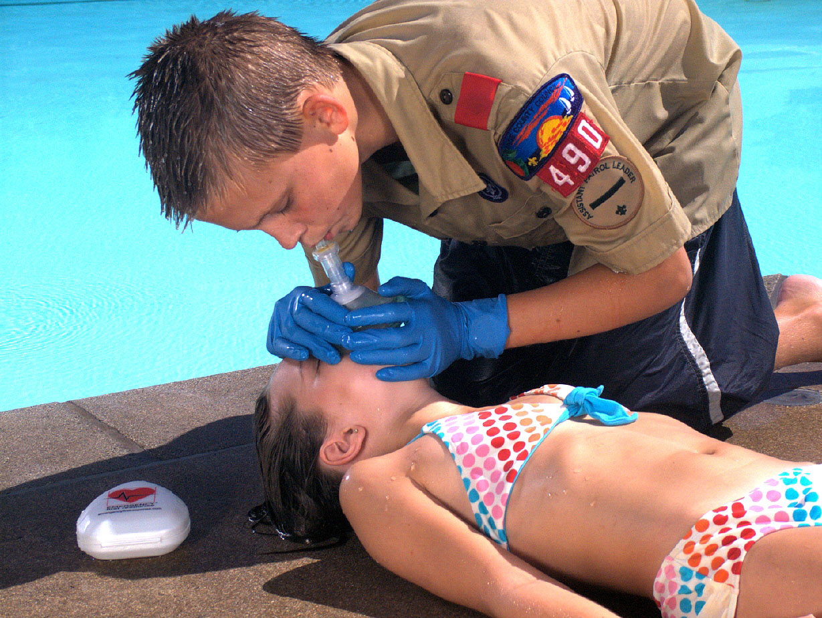
First Aid & CPR
Rescue Breathing
Child Rescue Breaths:
Call 911
Give 2 initial breaths
Search for a Pulse (5-10 sec)
Maintain open airway
Deliver 1 full slow breath every 3 seconds

Slide 11
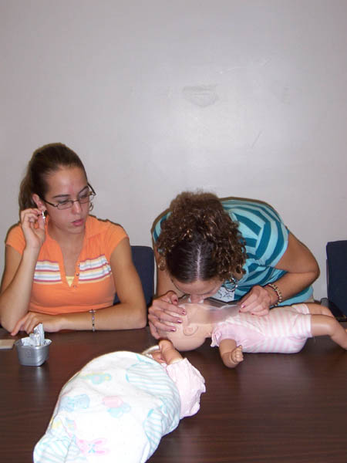
First Aid & CPR
Rescue Breathing
Infant Rescue Breaths:
Call 911
Give 2 initial Puffs
Search for a pulse
  Use Brachial Artery
Maintain open airway
Deliver 1 Puff of breath every 3 seconds

Slide 12
Rescue Breathing
After 2 minutes, recheck signs of life & pulse for no more than 10 seconds.
If pulse present continue rescue breathing
If pulse absent begin CPR

Slide 13
Rescue Breathing
Rescue breathing – Adult – 2:06 http://www.youtube.com/watch?v=TBaswzaYyBU&feature=related
Rescue breathing - Child - 2:28 - http://www.youtube.com/watch?v=uQkChfhWcwk&feature=related
Rescue breathing – Infant - http://www.youtube.com/watch?v=loWG7nCIuMA&feature=related

Slide 14
Rescue Breathing
Get with a partner &
Practice Rescue Breathing
Adult - Child - Infant
Start with Primary Survey

Slide 15
Rescue Breathing
Survey Scene
Hey are you okay? – Pinch
Open Airway
LLF
Call 911
2 breaths
Search for a pulse – has pulse
Continue Rescue Breathing

